Slide 1


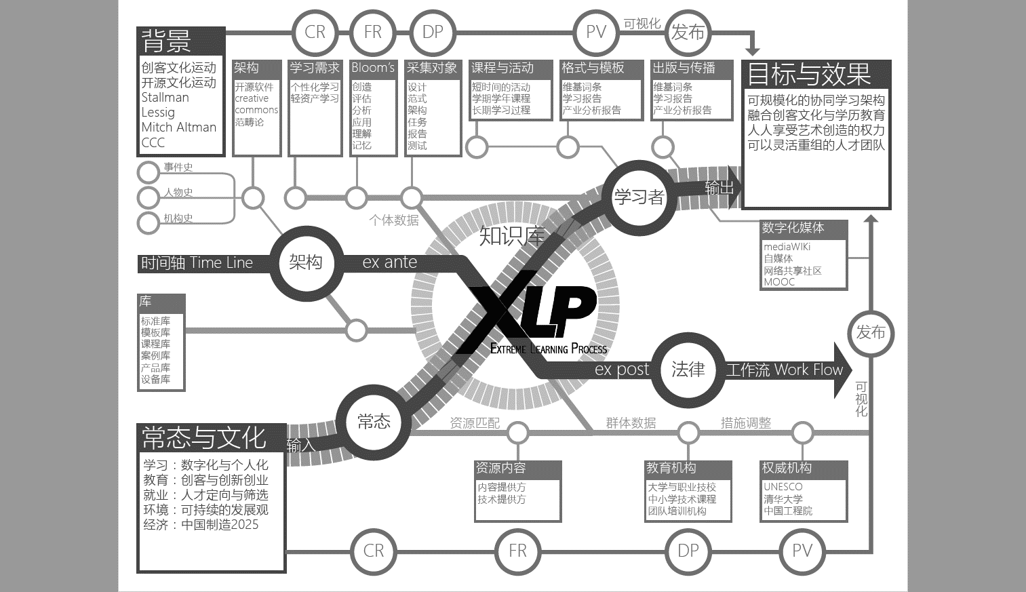



《超越学科界限的认知基础》 第一讲
认知功能来自一套隐喻体系
主讲老师：顧學雍
助教：陶仁鹏
课程wiki主页：toyhouse.cc
2016年秋 周五 13：30~16：50
地点：李兆基大楼634

Slide 2
Colophone: 扉页
Usage and Copyright Notice: Copyright © Toyhouse
We provide 16 such presentations and many additional lectures by invited speakers
Each presentation is designed to support about 3 hours of classroom or self-study instruction. You are welcome to use or edit this presentation as you see fit for instructional and non-commercial purposes. If you use our book and course materials, please include a reference to www.nand2tetris.org
and toyhouse.cc
If you have any questions or comments, please write us at koo0905@gmail.com
超限學習過程
This work is licensed under a
Creative Commons Attribution-NonCommercial-ShareAlike 3.0 Unported License.

Slide 3
背景
新雅书院希望为大二同学进行跨学科学习、知识管理、科学素养、群体协作能力训练
本次课程参与者涵盖10个科系：工科占多数
课程会尝试采用网络化知识管理工具来支持全体师生的沟通（包括微信）。
目标
学生个体：拓展个人表述认知深度与广度的能力；通过参与出版工作流、吸收多层次的反馈；
小组层面：通过本学期的自选研究主题，围绕一个主题。
课程层面：建立数字化的长期群体协作机制；持续梳理跨学科知识框架。
效果
输出
过程
输入
Demo：How a
LM Works？
将多年来的课程累积成果，使用数字出版工作流、学科全景图制作，长期演化
课程效果总结
根据期末的书面与现场报告评价效果 （计分）
个人/小组的自我收获总结
学习过程评判：
过程数据所反映的学习进程。
个人主页&认知结构梳理 ……25%
周学习报告 ……25%
群体协作执行手册 ……10%
认知机制全景图 （清华辞典） ……40%
基于计算思维的认知科学参考文献
工具
基于Wiki的知识管理工具。
Wechat Group
Git等群体协作工具。
课程导引
日程表
任务指南
项目验收表
参考文献列表
课堂讲解
嘉宾演讲
撰写学习报告：
对阅读成果的mapping；
对新的名词的命名空间管理
撰写个人page
认知自己
包装自己
撰写学科mapping
群体跨学科学习
外部因素
参与者入学时间短，对专业知识了解层面浅，
因根据考试成绩导向的学习习惯，导致无法吸收课程内容；
现场助教缺人数，录像、主持可能存在人力问题；

Slide 4

教育部资助的清华大学学校特色项目： ABC 认知科学与计算思维的课程体系:
刚入门的新生导引课程，全面体验数字社会的群体运作基本机制
经由对人物、科技、机构／制度的线索、撰写产业分析报告
自愿参与课程设计
的前期学生
A. 产业前沿
任务
执行方
挑战
设计方
Industry Frontier
从逻辑闸门到人工智能应用的计算服务系统
B. 计算思维与系统设计
课题
C. 认知基础课的专项
技术架构
汽车设计方法
智能居住系统
制造业与物流服务整合。。。
Domain-Specific Courses
超越学科界限的认知基础
Based on Legal Protocols in Global Creative Commons

Slide 5
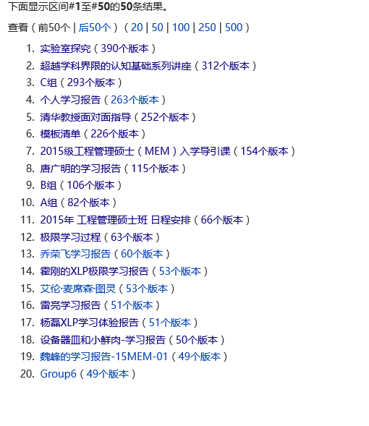
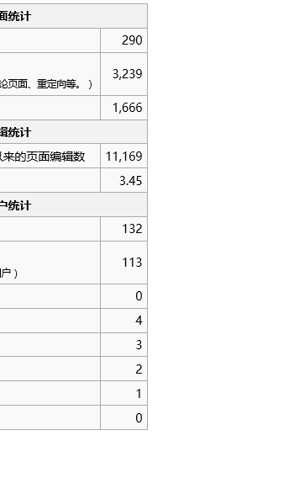
输出：清华辞典项目

Slide 6
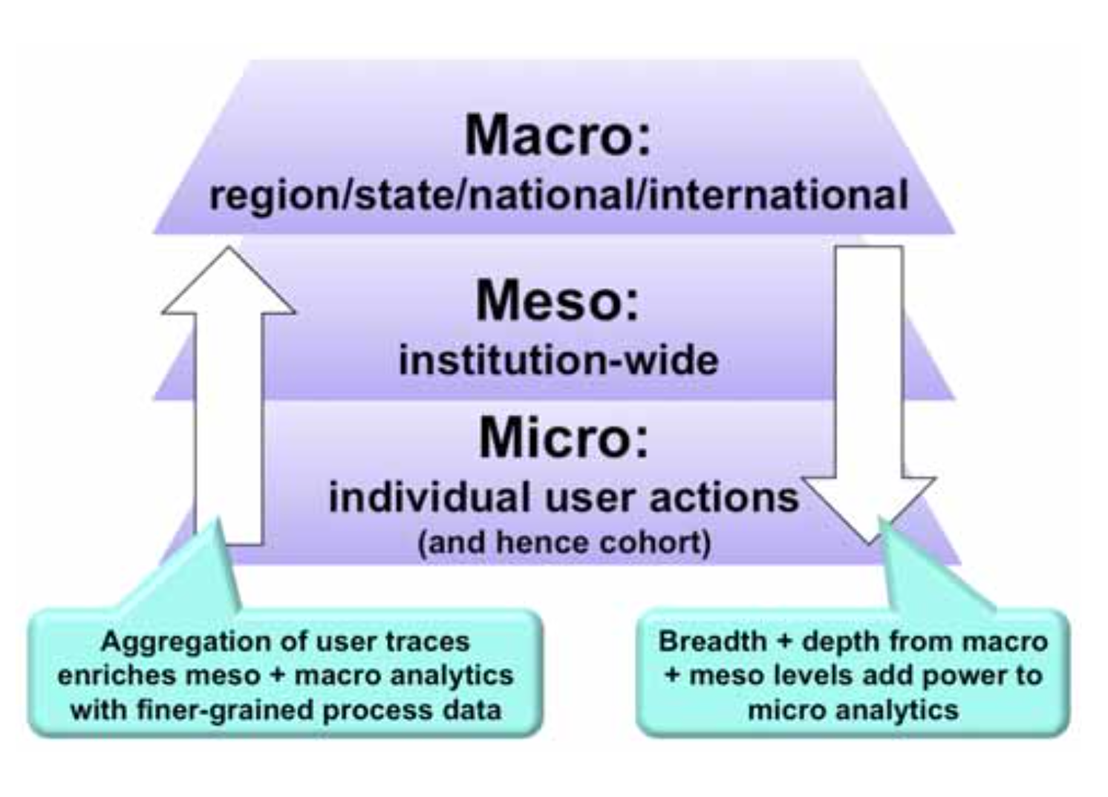
学习行为数据的三层次
法学／社会科学
建筑学院／生物系统/电子化控制系统
生命科学／基础力学／电子元器件
图片来源： UNESCO IITE Policy Brief on Learning Analytics 作者：Simon Buckingham Shum

Slide 7
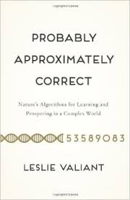





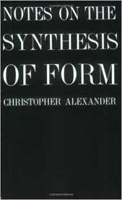
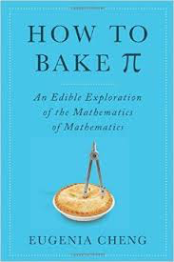


比对不同学科语汇体系之异同
Macro
(History/
Evolution)
Many
Legal
Cases
Meso
(Architecture)
Meso
(Life Science)
Machine and Human Languages
In the digital space.
Micro
(Math/Linguistic)

Slide 8
其他信息
如果关于课程、认知基础等问题有任何疑惑、想法、灵感，欢迎用任何方式联系我们。
陶仁鹏
电话：15600361919
顾学雍
Email：benkoo@mail.tsinghua.edu.cn
微信：koo0905
办公室：李兆基科技大楼B572
極限學習過程

Slide 9
01
课程合约
01

Slide 10
课程合约-2 逻辑模型：计算思维概念下的设计合约
逻辑模型是一个计算思维概念下的设计合约/函数，在特定的场景下帮助我们基于目的进行工作流设计。
背景：任何的行为都有特定的场景/背景/参考系，抛离场景的思维是没有意义的
目的：在指定的场景下，希望达到什么样的目的
逻辑思维作为基本的设计合约。在本课程中，不论是书写个人学习报告、群体协作协议、最终的出版物，都需要出现逻辑模型
将需要达到的目的，具体化为几个具象化的效果
验证效果需要的出版物
基于出版物设计的工作流和群体协作宪章，在两者的约定下进行特定的活动
基于工作流，准备相应所需的材料
外部因素：考虑边界、极值、压力测试等情况
http://fyi.uwex.edu/programdevelopment/logic-models/
10

Slide 11
Why wiki？
知识：命名空间管理
新知识：新的词汇
Wiki：基于词汇的高度结构化工具
Wiki good enough？
Not enough
课程合约-3 课程格式：进入计算思维的学习时代
01
02
上课形式
工具
时间安排
授课50%
讨论20%
展示30%
课程任务
29名同学，5~6组
第一周团队任务1.0
教学组一周挑战
本周报名挑战课程
核心工具：wiki
链接：toyhouse.cc
账号：学号；
初始密码123；
课程知识管理；
个人主页、报告；
群体协作协议、报告

Slide 12
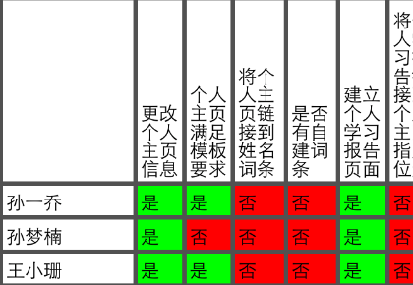

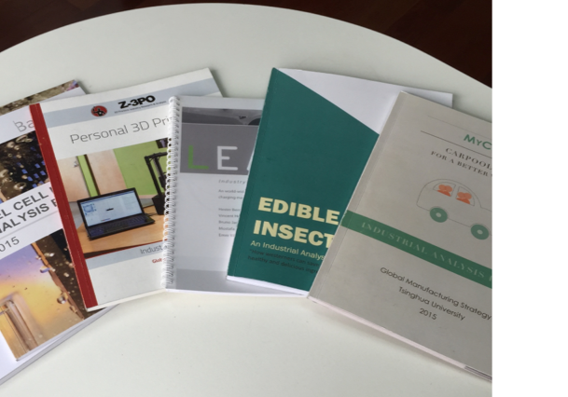
课程合约-5 出版物合约
个体层面
个人主页 20%
周学习报告 10%
个人知识结构展示 20%
A
评分表
验证的方式不止考试一种。
考试：一次验证？消逝？
本课程不设置考试。
分数将采用多层次、层次迭代的标准数据验证方式进行评价。
群体层面
群体协作执行手册
10%
任务手册
B
知识
层面
C
学科知识全景图 40%
报告

Slide 13
第一周个人任务：进入计算思维的学习时代
开始运用Jupyter, Mathematica或NetLogo，找到一个自己有兴趣相关的范例，撰写学习报告。
在wiki上建立相关的介绍。参考该范例的注释与关键词的链接，撰写更加细腻的介绍文件。
使用template撰写学习报告，注意命名空间管理，并将学习报告链接到个人主页。
请注意：学习报告需至少有关键词、文献参考、参考链接和逻辑模型。
内容提示：字数建议（至少1000字以上）
如果缺乏思路：先写逻辑模型，再撰写内容。
写过内容后：跟课程的逻辑模型（P.3）比对，是否扣题

Slide 14
第一周团队任务
团队合约
协调团队的研究主题：提出至少一个主题的描述文件：
先撰写一个逻辑模型
至少要有十个可在维基上链接的文献（有版权的书籍可链接到相关出版社的书籍介绍页面）
使用清华大学图书馆所提供的文献索引软件，并不断将文献索引的文本更新上传至GitHub项目
掌握Wiki的语法和内容链接与内容统计的各项功能。
将逻辑模型、主题描述内容、文献链接都收录在第一周的小组网页
共同撰写第一次团队学习进度报告
第二周团队任务：内容责任圈
请按照文档《内容责任圈》的相关协议，将相关的认领意向书写到团队学习报告上。
团队群体协作协议入门
阅读合弄制宪章，合弄制快速入门英文版PDF等内容，初步讨论团队内部角色与分工。并记录在报告里

Slide 15
2017年9月 作业参考案例
MEM
2017
X L P
5
宪章

Slide 16
逻辑模型
思路
工作流
小组课程输出
背景 | *清华大学MEM办学六届，至今没有成行的MEM联合会宪章。 *迫切需要对清华大学MEM全体学员的行为进行约束和引导，建立一套完整的流程和规范。
目标 | *短期：通过宪章的规范和指引，使学员能够充分利用和整合班级的资源完成各项任务和活动。 *长期：优化MEM资源利用和整合，加强学生、老师与学校之间的沟通互动，为学生提供更好的学习体验和收获，树立和发展MEM平台。
效果 | 输出 | 过程 | 输入
*规范MEM成员参与班级活动的行为。 *形成可自我更新优化的社群网络。 *通过视觉识别和优良工程管理实践，高效输出学员质量，树立MEM品牌。 | *2017级清华MEM班级宪章，并且积累过程迭代版本。 *组织架构、开会、决议/决策的工作流程，奖惩机制、经费管理办法、数据管理、文化建设、沟通渠道。 *2017级MEM社群网络。 | *宪章逻辑架构搭建、内部逻辑关系及其内容概述。 *各模块内容的细则分解。 *各模块内容的整合，完成宪章更新。 *宪章的迭代修订，小组评审。 *班级评审。 | *2017清华MEM入学新生。 *老师及学长指导 *参考资料：2017级社群画布指导书译文版、2016级合弄制中文版。清华大学MEM班级宪章2017年MEM第一批XLP班级版本 *学员兴趣、行业背景、优势收集。 *软件支持：wiki、GIT。 *环境：现场教学环境。
外部因素 | *同学间的背景差异所引起的不同的认知体系和学习方法。 *物理空间、网络等不稳定因素。
团队简介

Slide 17
逻辑模型
思路
工作流
小组课程输出
目标：大家关心参与
逻辑分析
逻辑分析
普通同学：资金，交流，信息
班级管理者：管哪些方面，怎么操作
关心的问题
团队简介

Slide 18
逻辑模型
思路
工作流
小组课程输出
逻辑模型
社群画布（思路）
合 弄 制（思路）
宪章的内涵（底限、指引）
回归逻辑分析
标准：可操作
宪章V2.0
宪章 V1.0
逻辑分析
修订的大纲
丰富内容
更新方案
迭代更新
班级是单位
圈子是细胞
经验分享加分
营造社群文化
经费管理
团队简介

Slide 19
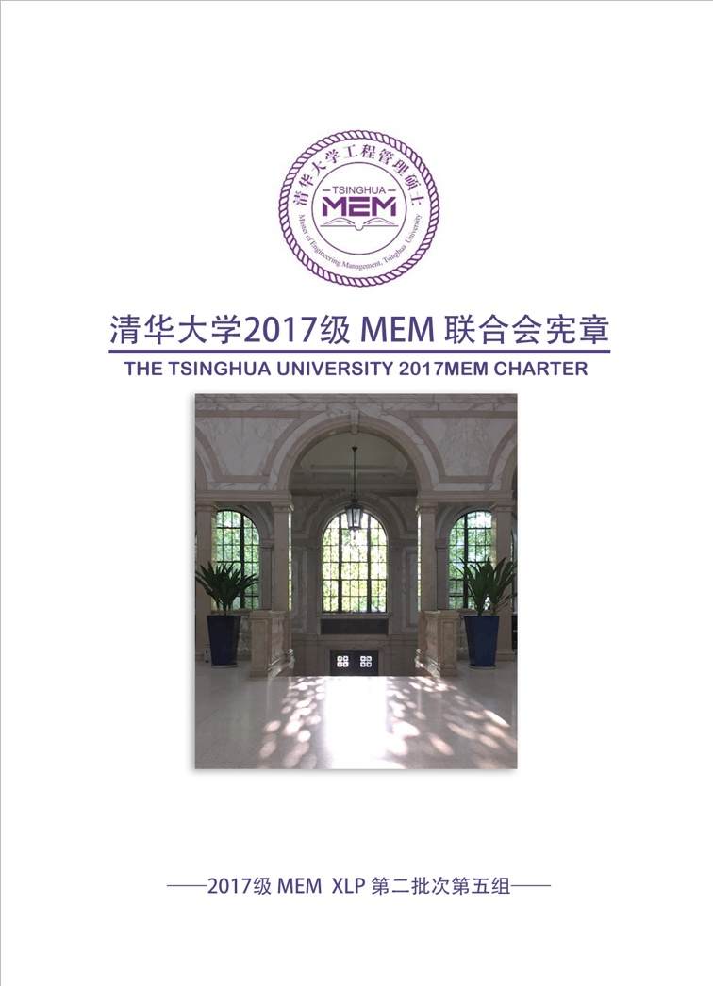
逻辑模型
思路
团队简介
小组课程输出
WIKI第五组主页可下载
团队简介

Slide 20
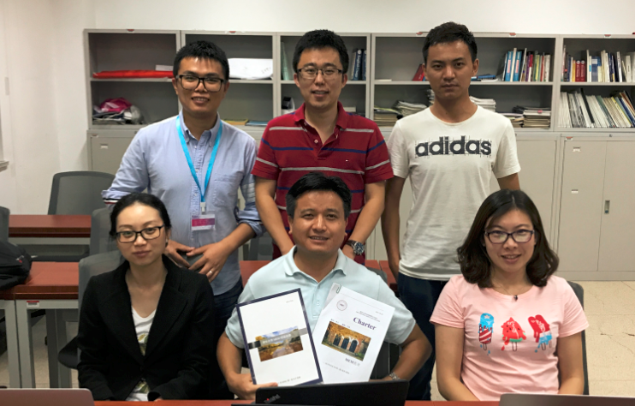
逻辑模型
思路
工作流
小组课程输出
编者：
易文轩 周鹏 汤洋
魏洁 洪德智 王芳
美编：张斯斯
团队简介

Slide 21
MEM
2017
X L P
5
宪章
谢谢

Slide 22
Take A Break
请大家在5分钟的休息时间里确保自己可以登录wiki账号
账号：学号；初始密码：123
如无法登陆，请联系陶仁鹏学长、
尽快在wiki找到我们的课程，尝试建立个人主页

Slide 23
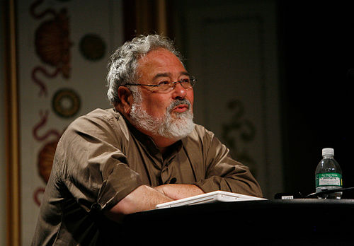


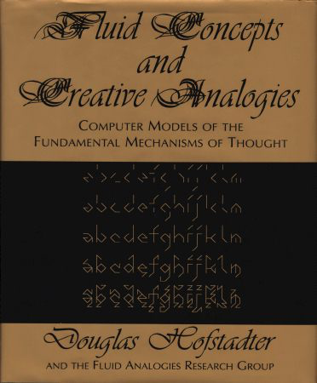
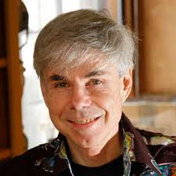
抽象的认知单元：隐喻／函数／算法／关系
George Lakoff: 万事万物认知的基础是：
Metaphors we live by!
Douglas Hafstadter:
Analogies are the basis for
all Cognitive activities…
Analogy as the Fuel and Fire of Thinking

Slide 24

Will “The Master Algorithm” Reframe Our World?
Bill Gates’ recommendation
The main idea of this book:
Processing data through a single universal learning algorithm— can get all the knowledge from the past, the present, and the future
Pedro Domingos, TMA, P. 25
中译本

Slide 25
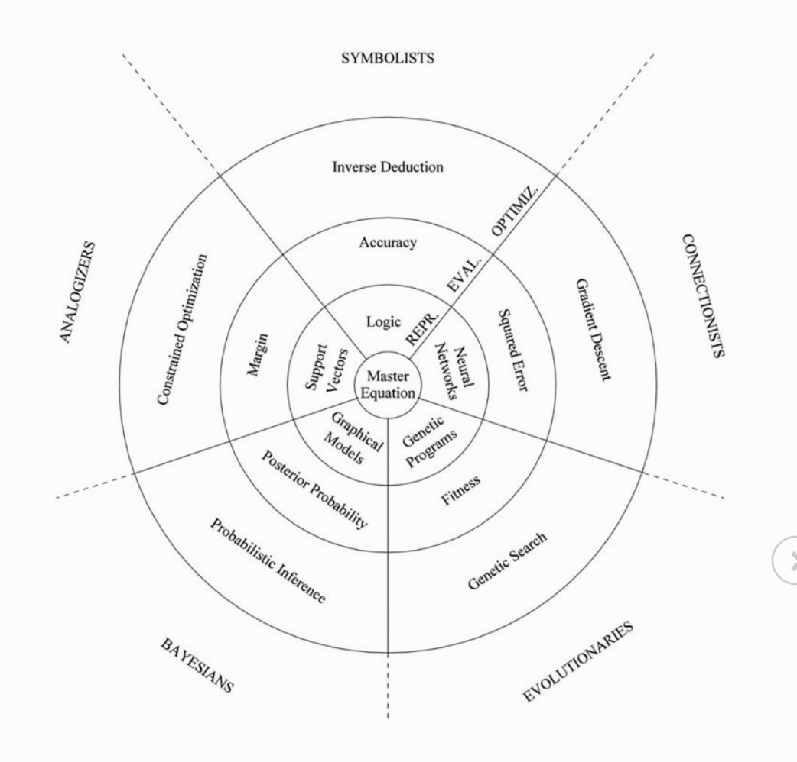
Five Factions of Algorithm

Slide 26




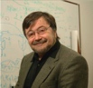




Knowledge System based on Computational Thinking
Software
Hardware
Gene Evolution
Neutral Network
Symbolic Logic
Causal Probability
Cognitive Semantics
T. Kuhn
Content
IoT and Quantum Computing
TPU
GPU
CPU
Big Data
Computed Data
Artificial Data
Thinking
Standard
D. Hassabis
Distributed
Centralized
General Protocol
S. Wolfram
Extreme Learning Process
J. Pearl
Forms of Knowledge
Computable collective learning system
G. Lakoff
Memory space, theme
Computational ability, energy, equipment
Coding strategy, structure, algorithm

Slide 27




Computation of Reliability
Time
Space
Reliability

Slide 28
隐喻的分类：本体／空间／系统
本体隐喻：脑中的概念与实体世界的联系
已熟悉的词汇 （如桌椅、门窗、飞禽走兽。。。）
空间隐喻：各物品或概念单元的时空定位关系
物件中的上下左右、事件发生的前后（偏序关系）
社会地位、亲属联系的高低大小关系
系统隐喻：整套物品（事件）的结构类似性
机器人对应与木流牛马
计算机的作业系统对应与国家的宪章

Slide 29
不论群体或是个人的“认知”都可用隐喻来解释
认知科学 | 数学（范畴论） | 社会学
本体隐喻 | 集合中的元素、特定的数值（0、1、3、e、pi、), 代数符号 （x、y、z）、 | 已知概念（数字、机构、指标、货币、。。。）
空间隐喻 | 数值之间的对应关系，（函數 Function) | 历史关系、合作关系 （产业链上下游关系），竞争关系
系统隐喻 | 不同範疇（Category）之間的結構對應关系（函子，Functor） | 知识地图、战略地图、产业或知识体系的演进过程（过程本身当作一种新旧之间的联系）

Slide 30
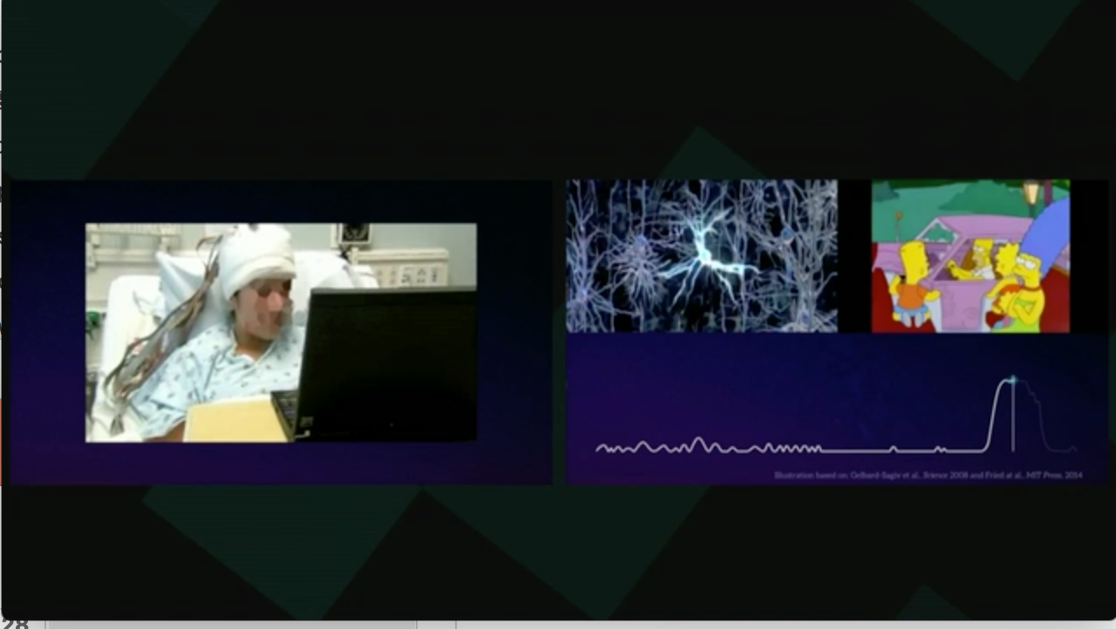
本体比喻 (Ontological Metaphor)
Moran_Cerf on Brain Hack TED 2016

Slide 31
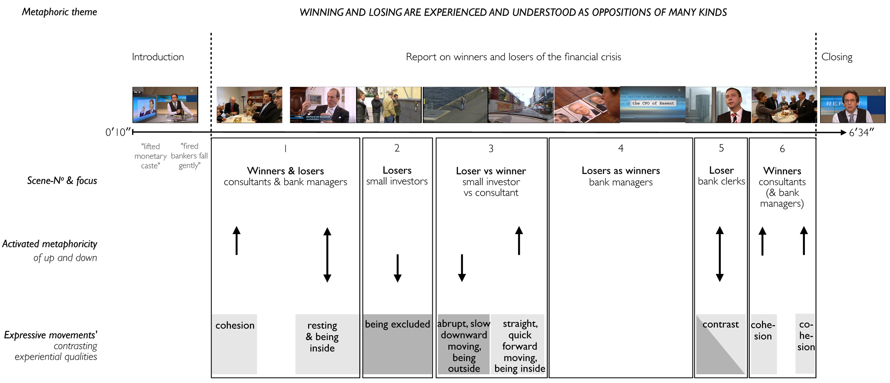
空间比喻 (Orientation Metaphor)
Audio-visual metaphors of the financial crisis: meaning making and the flow of experience
http://www.scielo.br/scielo.php?script=sci_arttext&pid=S1984-63982015000200311

Slide 32
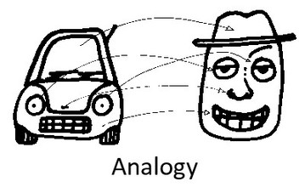
系统比喻 （System Metaphor)
http://www.eoht.info/page/Analogy

Slide 33
认知的分类：个体认知能力／群体认知能力
个体认知：脑中概念的三类隐喻机制
语汇、语法、语境
群体认知：群众共同产生的概念隐喻机制
热门词典
约定成俗的行为规范
可确保成效的法规执行机制或交易渠道

Slide 34

产业与科学革命的知识体系奠基人：Thomas Kuhn
Thomas Samuel Kuhn (/ˈkuːn/; July 18, 1922 – June 17, 1996)
https://en.wikipedia.org/wiki/Thomas_Kuhn

Slide 35
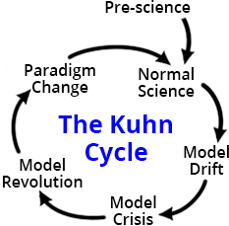
分析产业变革的Kuhn Cycle
产业变革来自新科学知识或新工程科技所带来的“危机”，特别是认知过程中的各种困扰。
http://www.thwink.org/sustain/glossary/KuhnCycle.htm

Slide 36

关键词：Incommensurability （不可通约）
产业创新导致行为“范式”的转移
Paradigm shift (范式转移）
传统产业的范式，不再适用于新的社会环境
http://plato.stanford.edu/entries/incommensurability/
http://foodtank.com/news/2015/01/five-ways-cell-phones-are-changing-agriculture-in-africa

Slide 37
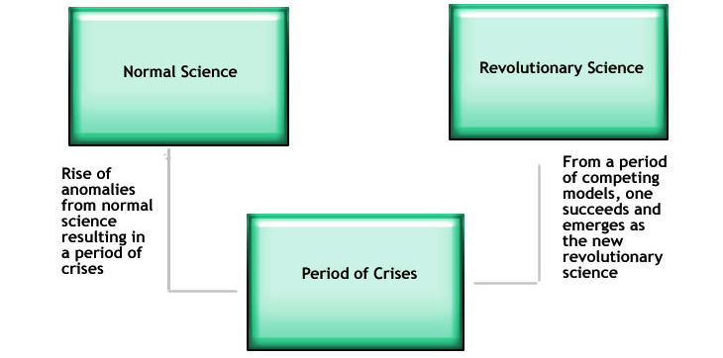
理解效果跟比喻的恰当性
http://structural-communication.com/Articles/Anatomy-metaphor-stclair.html

Slide 38



Category Theory (范畴论) makes Cognitive Processes Computable/Comparable
Ben Koo

Slide 39
What is Category Theory?
Contents
System Modeling in a Nutshell
How Does Category Theory Help?

Slide 40
01. What is Category Theory?

Slide 41





Category Theory
Viable airspace
trajectories
Blockchain
Is the tool to represent and compute complex networks
Cognitive and Brain Science
A.I. decision Matrix
Start-Up viability
Predict formerly unpredictable
Solve the Mysteries of Life
Notes:
Predict formerly unpredictable

Slide 42

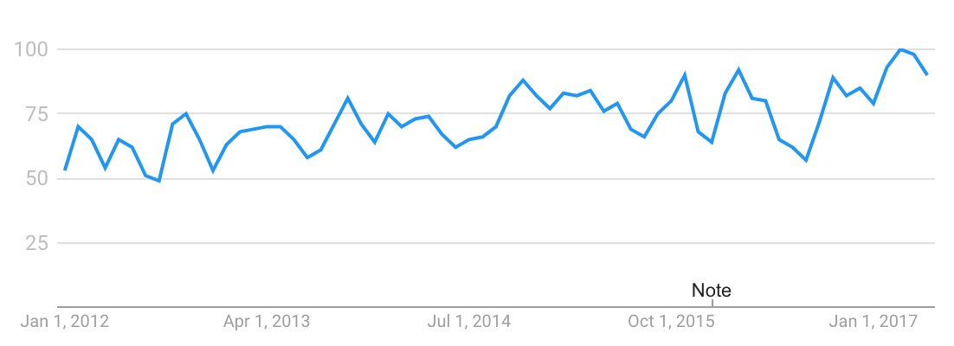
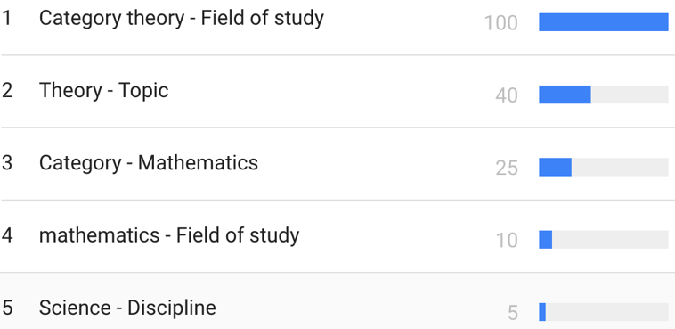
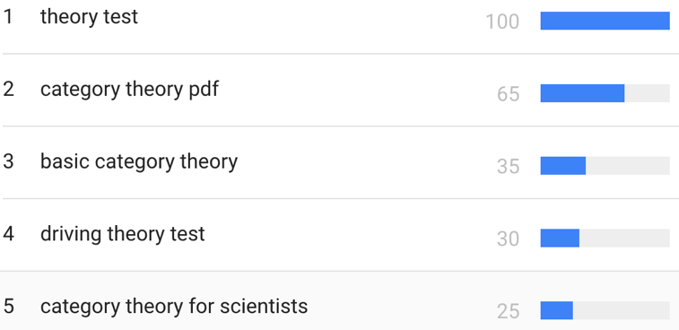
Trend
Based on
“category theory” interest over past 5 years (worldwide):
Legend:
Numbers represent search interest relative to the highest point on the chart for the given region and time.
A value of 100 is the peak popularity for the term.
A value of 50 means that the term is half as popular.
Likewise a score of 0 means the term was less than 1% as popular as the peak.
Related topics
Related queries
Legend
The most popular topics. Scoring is on a relative scale where a value of 100 is the most commonly searched topic, a value of 50 is a topic searched half as often, a value of 0 is a topic searched for less than 1% as often as the most popular topic.
Legend
The most popular topics. Scoring is on a relative scale where a value of 100 is the most commonly searched topic, a value of 50 is a topic searched half as often, a value of 0 is a topic searched for less than 1% as often as the most popular topic.
Notes:
Category theory has become an important role in contemporary mathematics and theoretical computer science.

Slide 43
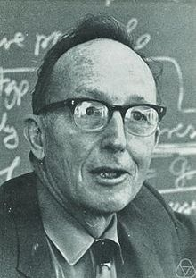
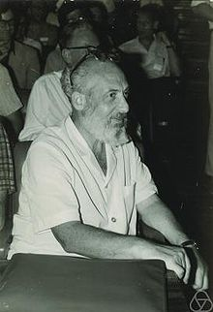
Founders of Category Theory: Saunders Mac Lane/Samuel Eilenburg
https://en.wikipedia.org/wiki/Saunders_Mac_Lane
https://en.wikipedia.org/wiki/Samuel_Eilenberg
Notes:
Category theory has become an important role in contemporary mathematics and theoretical computer science.

Slide 44
Mathematical Models: A Sketch for the Philosophy of Math (1981)
Mathematics begins with puzzles and problems dealing with combinatoric and symbolic aspects of the general human experience. Some of these aspects turn out to be systematic and intrinsic, rather than arbitrary and tied to one context. … These observations can be described as starting with a variety of human activities, each one of which leads more or less directly to a corresponding portion of mathematics:
http://links.jstor.org/sici?sici=0002-9890%28198108%2F09%2988%3A7%3C462%3AMMASFT%3E2.0.CO%3B2-D
Notes:
Category theory has become an important role in contemporary mathematics and theoretical computer science.

Slide 45
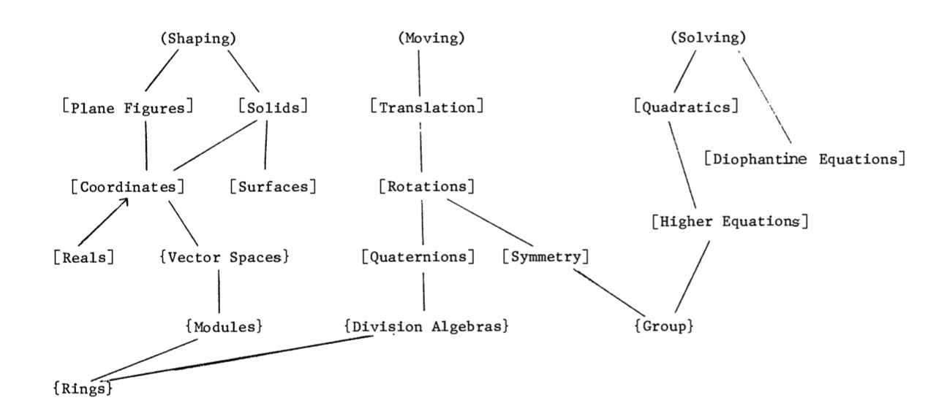
Mathematical Models: A Sketch for the Philosophy of Math (1981)
The Lower part of the Table 1 of the paper
http://links.jstor.org/sici?sici=0002-9890%28198108%2F09%2988%3A7%3C462%3AMMASFT%3E2.0.CO%3B2-D
Notes:
Category theory has become an important role in contemporary mathematics and theoretical computer science.

Slide 46
Mathematical Models: A Sketch for the Philosophy of Math (1981)
Mathematics begins with puzzles and problems dealing with combinatoric and symbolic aspects of the general human experience. Some of these aspects turn out to be systematic and intrinsic, rather than arbitrary and tied to one context. … These observations can be described as starting with a variety of human activities, each one of which leads more or less directly to a corresponding portion of mathematics:
Counting | Arithmetic, Number Theory
Measuring | Real Numbers, Calculus, Analysis
Shaping | Geometry, Topology
Forming | Symmetry, Group Theory
Estimating | Probability, Measure Theory
Moving | Mechanics, Calculus, Dynamics
Calculating | Algebra, Numerical Analysis
Proving | Logic
Puzzling | Combinatorics, Numer Theory
Grouping | Set Theory, Combinatorics
http://links.jstor.org/sici?sici=0002-9890%28198108%2F09%2988%3A7%3C462%3AMMASFT%3E2.0.CO%3B2-D
Notes:
Category theory has become an important role in contemporary mathematics and theoretical computer science.

Slide 47
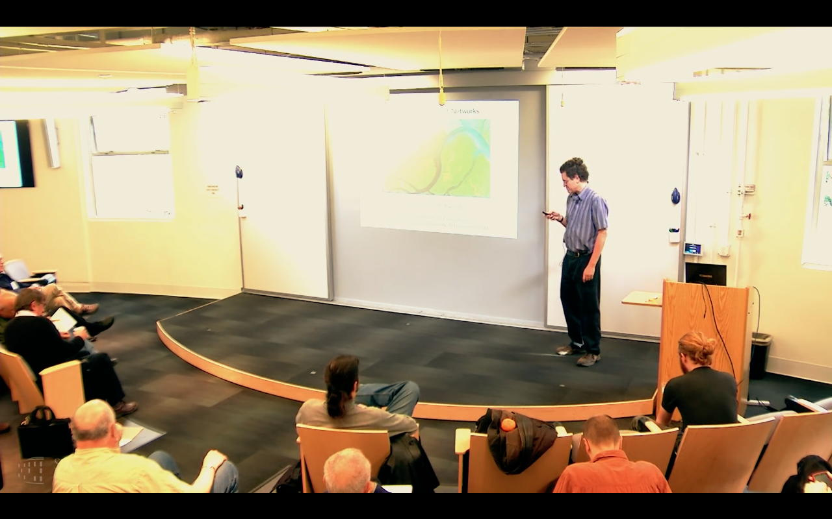
范畴论就是： 复杂网络的数学
John Baez* : “Category Theory is the Mathematics of networks.”
https://www.youtube.com/watch?v=IyJP_7ucwWo
Based on Marquis, Jean-Pierre on Stanford Encyclopedia of Philosophy**: “Category theory has become an important role in contemporary mathematics and theoretical computer science. It is a powerful language, or conceptual framework, allowing us to see the universal components of a family of structures of a given kind, and how structures of different kinds are interrelated”
Source: *John Baez’s Stuff, http://math.ucr.edu/home/baez/
**Jean-Pierre Marquis, https://plato.stanford.edu/archives/win2015/entries/categorytheory/
Notes:
Category theory has become an important role in contemporary mathematics and theoretical computer science.

Slide 48
Category Theory: Computation without numbers
A Category is a diagram composed of Objects and Arrows
B
f
g
h
A
C
Example: A Category with 3 objects (A,B,C) and two arrows (f, g)
“Category Theory is a graph with a rule for composing arrows (f,g) head to tail to give another arrow (h)。”
M. Barr, and C. Wells, Category theory for computing science. 1990. 21.

Slide 49
What is a Category?
A Category must satisfy the following conditions.
id_{B}
B
f
g
A
C
id_{A}
id_{C}
A collection of objects and a collection of arrows
Every object X must implicitly has an identity function id_{X}
Two or more arrows can be composed into another arrow

Slide 50
Category is all about composing functions
Two arrows ( f, g ) can be combined (composed ) into one arrow h
B
f
g
A
h
C
The essence of Category Theory is to represent the composability of functions

Slide 51
Category Theory computes with Diagram (Arrow) Chasing
B
B
Always implies:
f and g can be
composed into
h
where
h = g ◦ f
f
g
f
g
A
h
C
h = g ◦ f
A
C
Equational Reasoning h = g ◦ f

Slide 52





Three kinds of Arrows in Category Theory
Category theory : Arrow (morphisms) chasing
1. Function
$$A \underset{→}{ f } B$$
$$A$$
Object / Set $A$
Category $S$
A function $compares two objects$
2. Functor
B
$$S$$
$$\underset{→}{ F }$$
$$T$$
E
A Functor $compares two$categories
A
C
D
F
$$S \underset{→}{ F } T$$
Functor $F$
$$F$$
3. Natural Transformation
A Natural Transformation compares two Functors
$$S$$
$$η$$
$$T$$
$$F \underset{→}{ η } G$$
Natural Transformation $η$
Source : Schalk and Simmons, 2005
$$G$$

Slide 53
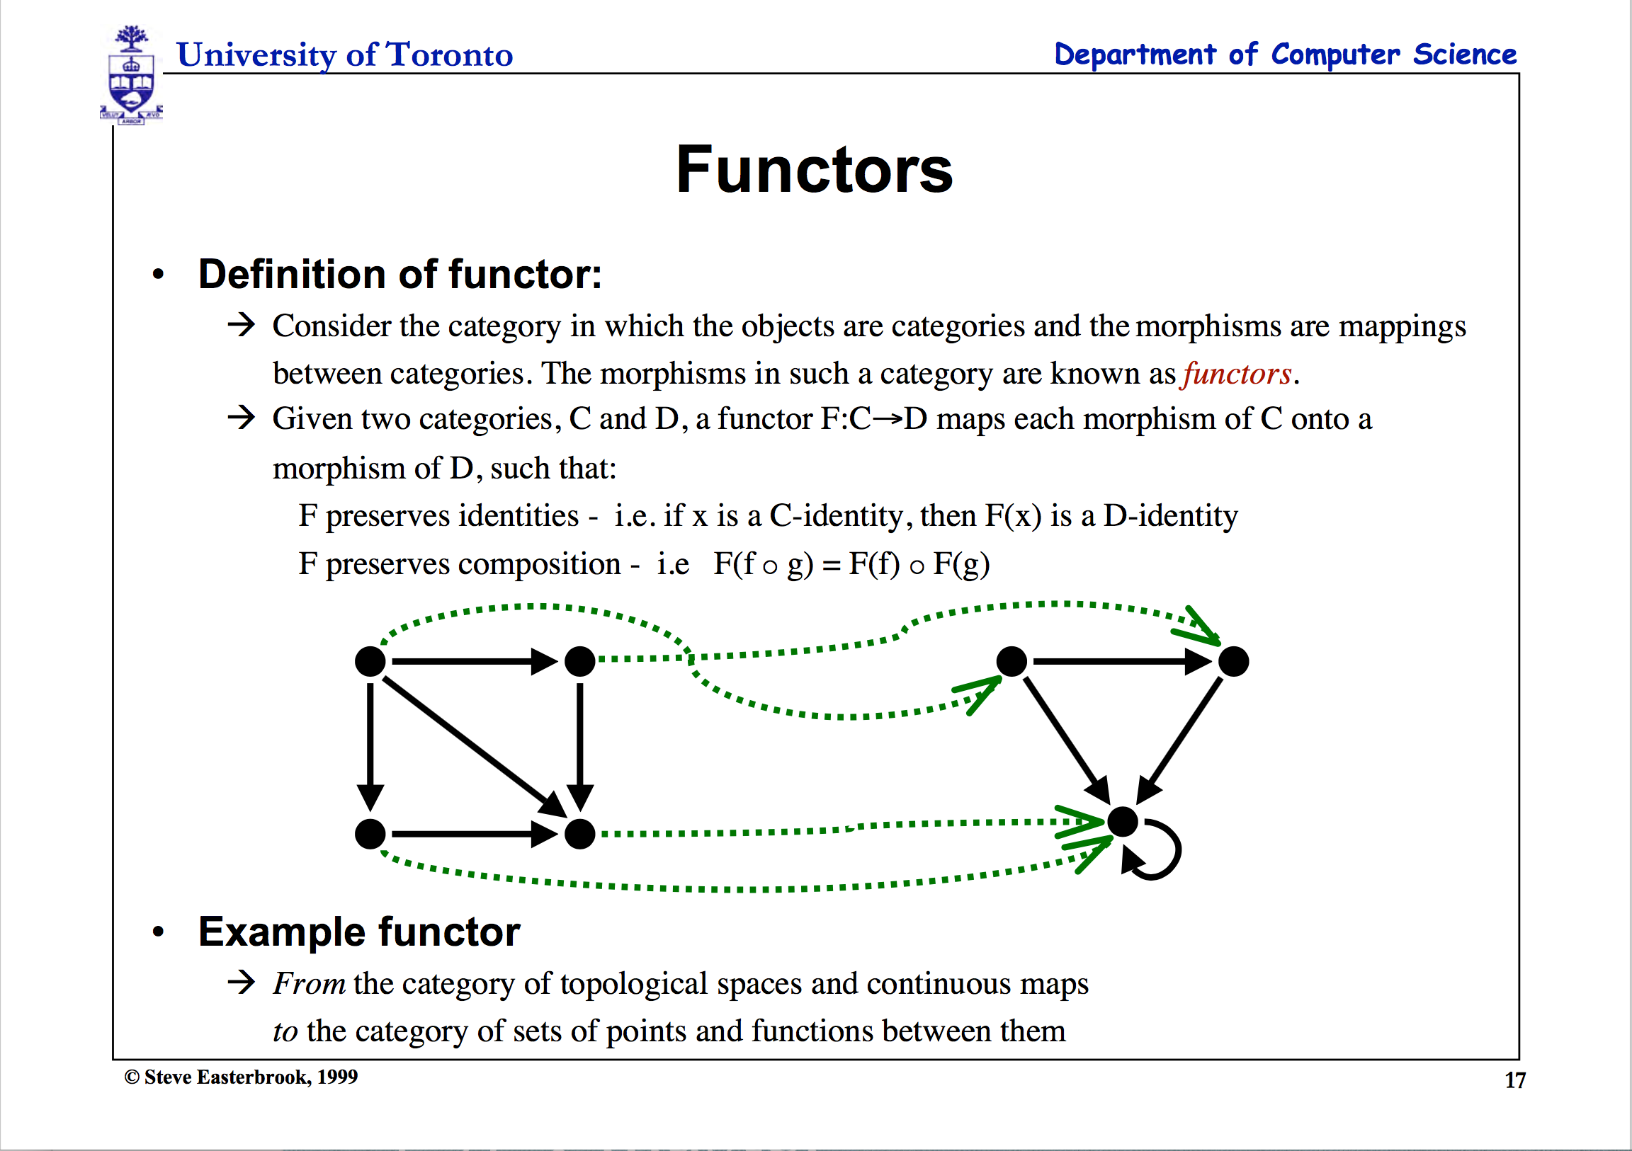

Slide 54
Arrows are “mappings” between objects, categories and functors
Category theory : Arrow chasing
1. Function
$$A \underset{→}{ f } B$$
$$A$$
Object / Set $A$
Category $S$
A function $compares two objects$
2. Functor
B
$$S$$
$$\underset{→}{ F }$$
$$T$$
E
A Functor $compares two$categories
A
C
D
F
$$S \underset{→}{ F } T$$
Functor $F$
$$F$$
3. Natural Transformation
A Natural Transformation compares two Fuctors
$$S$$
$$η$$
$$T$$
$$F \underset{→}{ η } G$$
Natural Transformation $η$
Source : Schalk and Simmons, 2005
$$G$$

Slide 55
Category Theory was invented to compare “Analogies”
Let’s see the example :
Functor
Category
Natural Transformation
Source : Milewski, 2015

Slide 56
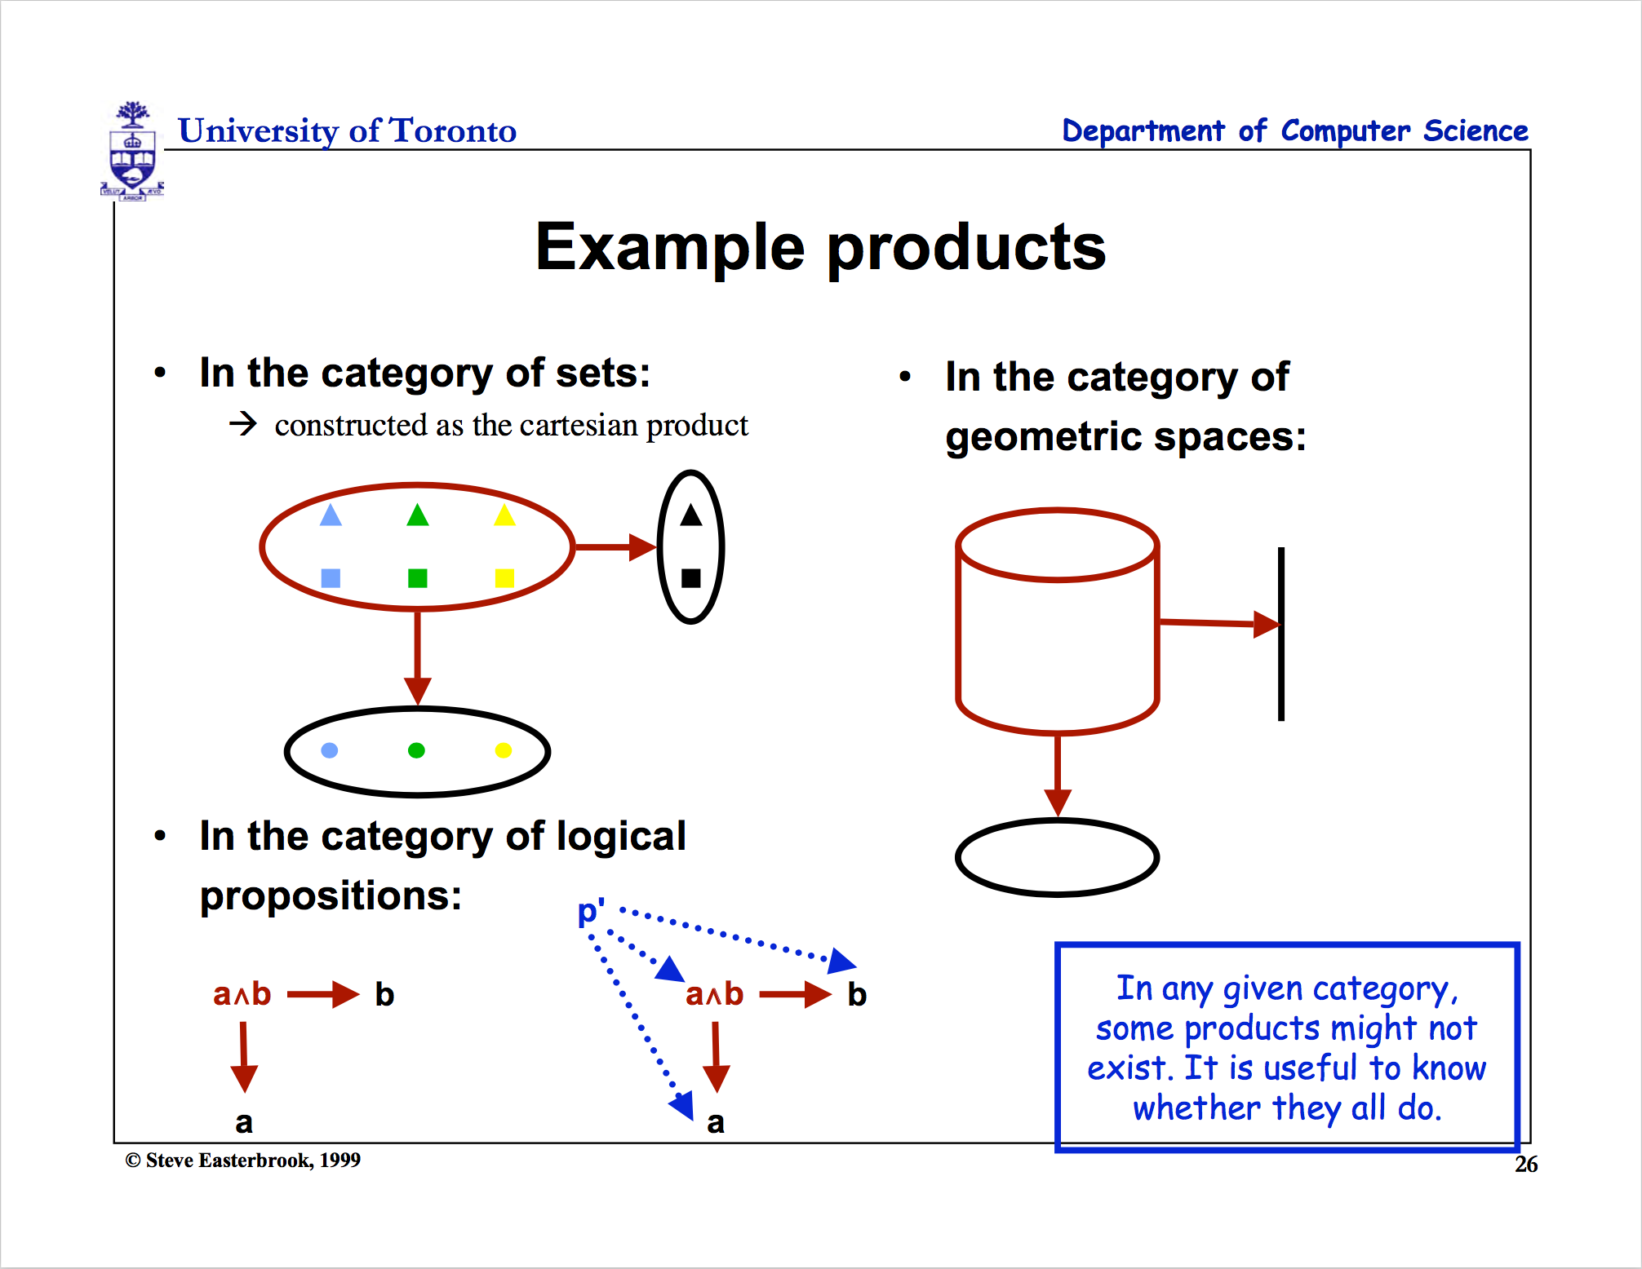

Slide 57
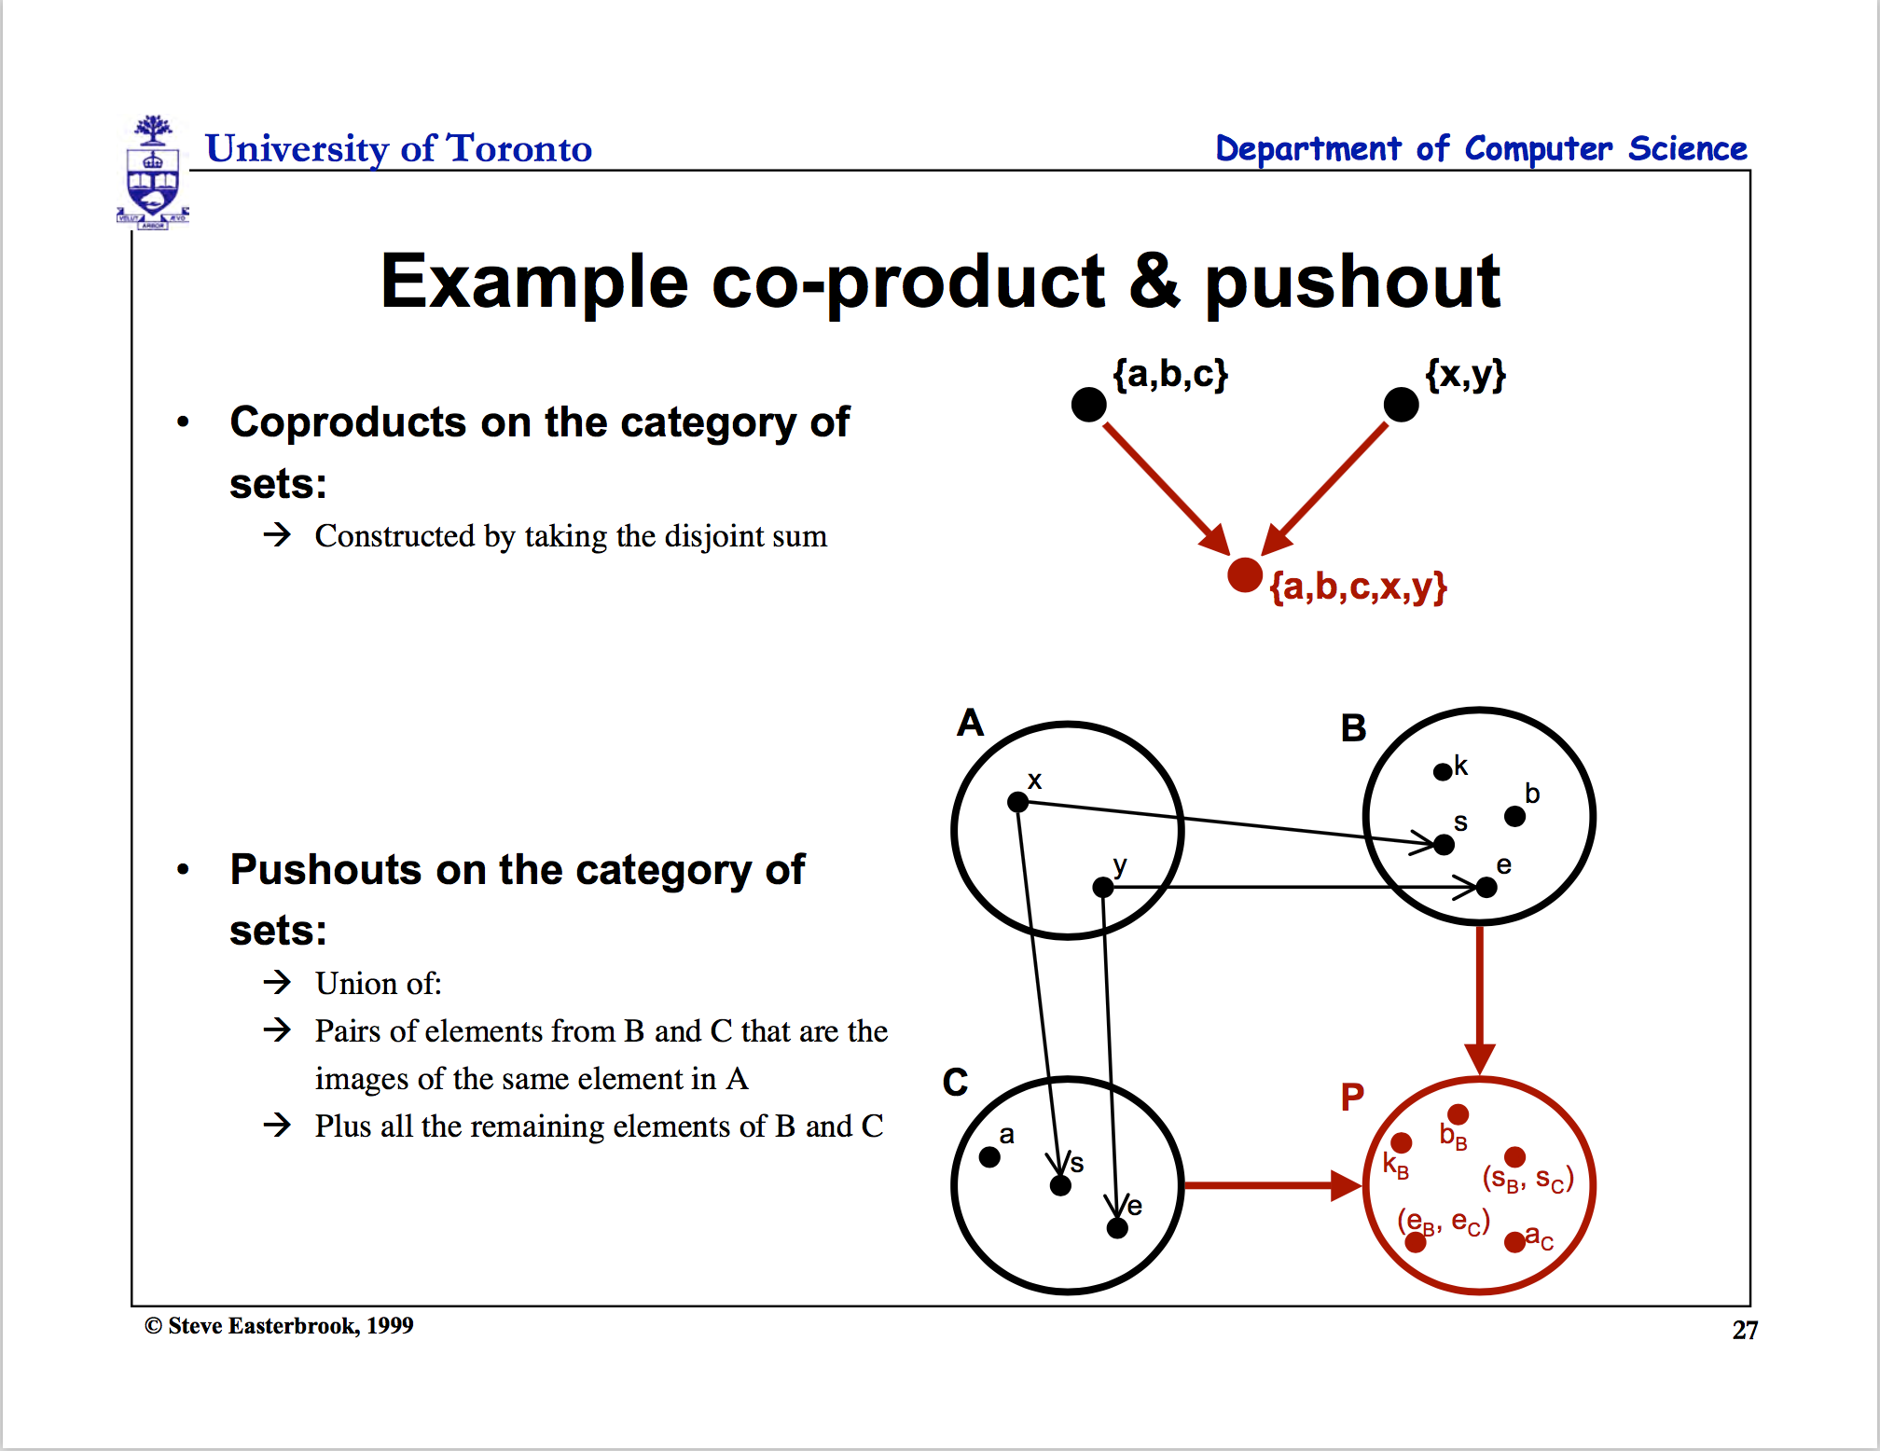

Slide 58


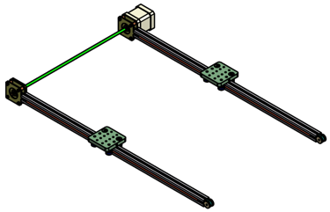
How are arrows chased and composed in real life?
Here’s another example :
C
C ^{OP}
3D printing
3D printing
F ^{op}
f
g
f ⁻¹
g ⁻¹
2D printing
1D movement
(Opposite Functor)
2D printing
1D movement

Slide 59


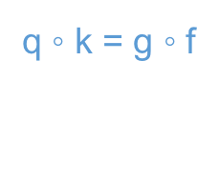


Functional Equivalence in terms of communitivity
Two paths that start and end on the same source/destination pairs represents: two functions (morphisms) that “commutes”
The crucial aspect of a category is that
two appropriately compatible arrows can
be combined (by composition ) to form a third
arrow.
h = g ◦ f
$$\underset{→}{ f }$$
$$\underset{→}{ g }$$
$$\underset{→}{ h }$$
$$\underset{→}{ f }$$
q ◦ k = g ◦ f
$$\underset{→}{ k }$$
$$\underset{→}{ g }$$
$$\underset{→}{ q }$$

Slide 60
02. Real life diagrams

Slide 61
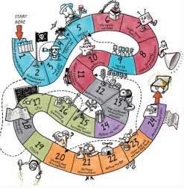

A Diagram of Product Development Process by Bill Aulet of MIT

Slide 62
Product Design and Development Process redrawn with arrows
Initial Idea
Identify Customer Needs
Establishing technical specification
Initial Idea
Collecting competitive benchmarking
Identify Opportunities
List of Customer Needs
List of Opportunities
Reflect on the result and the process
Evaluate and Prioritize Project
Establish the relative importance
Reflect on the result and the process
Filtered Opportunities
Filtered Customer Needs
Allocate Pre-project Planning
Interpret raw data in terms of customer need
Project Idea
Customer Needs Raw Data
Gathering Raw Data
Re-evaluate Result and Process

Slide 63
Product Design and Development Process redrawn with arrows
Target Specification
Concept Generation
Establishing technical specification
Final Product Concept
List of Metric Specifications
Measuring & interpreting concept
Reflect the result and the process
Collecting competitive benchmarking
List of Survey Result
Surveying concept
Competitive Evaluation List
List of Concept Scoring
Set Ideal marginal value
Scoring
Re-evaluate screening
Re-evaluate Result and Process
Target Specification List
List of Concept Screening
Screening
List of Concept Generation
Determining concept generation

Slide 64






Juicero by using Category Theory
C
g
h
h·g
F (Functor)
F (Functor)
Maps similar structures across categories
D
Notes:
Nespresso borrowed the insights from Hp, basically “If selling replacements is succesful then we have to focus on the replacements to succeed”
Borrowing experiences across industries to overcome Industry Barriers and failing one and again with the same complex problems.

Slide 65






Juicero by using Category Theory
Development Process
g
h
C’
F
h·g
F (Functor)
αG
C’’
Category Company C
F’ (Functor)
C’’’
Notes:
Nespresso borrowed the insights from Hp, basically “If selling replacements is succesful then we have to focus on the replacements to succeed”
Borrowing experiences across industries to overcome Industry Barriers and failing one and again with the same complex problems.

Slide 66


Juicero Case
What happened?
120M USD
Doug Evans
Notes:
Initial idea:
Innovative small press could change the juicing industry.
Identify Customer Needs:
Customers need juice or a press?
Customers need fast and clean juice making
Smart phone app to monitor their diet
Target Specification:
Thousands of pounds on 200 cm² surface press
Home appliance or Businesses?
Producing a juice in <90 s
Concept Generation:
Over engineered (24 pieces for the lock door system).
Cold pressured
QR scan to apply the exact pressure.
-----------------------------------------------------------------------------------------------

Slide 67





Juicero by using Category Theory
Company
Development Process
Promotion Channel
F
h
f
αG
Natural transformation
h
G
g
i
H
Notes:
Nespresso borrowed the insights from Hp, basically “If selling replacements is succesful then we have to focus on the replacements to succeed”
Borrowing experiences across industries to overcome Industry Barriers and failing one and again with the same complex problems.

Slide 68

Complex Diagram Can be Simplified by Category Theory
Represents ONLY SOME possible trajectories to the moon
NKS 2004, MIT A New Kind of Language for Complex Engineering Systems
Case Study: NASA’s Apollo Program Benjamin Koo
Edward F. Crawley

Slide 69
Complex Diagram Can be Simplified by Category Theory
A “language” for describing all
possible single craft itineraries
Maneuver | Acceleration | Time
Surface | K₀ =0 | Infinite
Orbital, Trim | K | Infinite
A -> B | variable | Finite
Orbit Departing
Orbiting
Transiting
Orbit
De-Orbiting
Direct
Ascent
“Trim
Trajectory”
Orbit Entering
NKS 2004, MIT A New Kind of Language for Complex Engineering Systems
Case Study: NASA’s Apollo Program Benjamin Koo
Edward F. Crawley
Orbit Attaining
Direct Decent
Surface
Source : Frazzoli (2001)

Slide 70
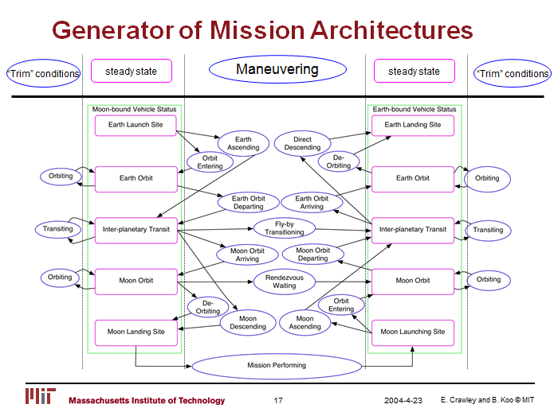
Complex Diagram Can be Simplified by Category Theory
Represents ALL possible trajectories to the moon
NKS 2004, MIT A New Kind of Language for Complex Engineering Systems
Case Study: NASA’s Apollo Program Benjamin Koo
Edward F. Crawley

Slide 71
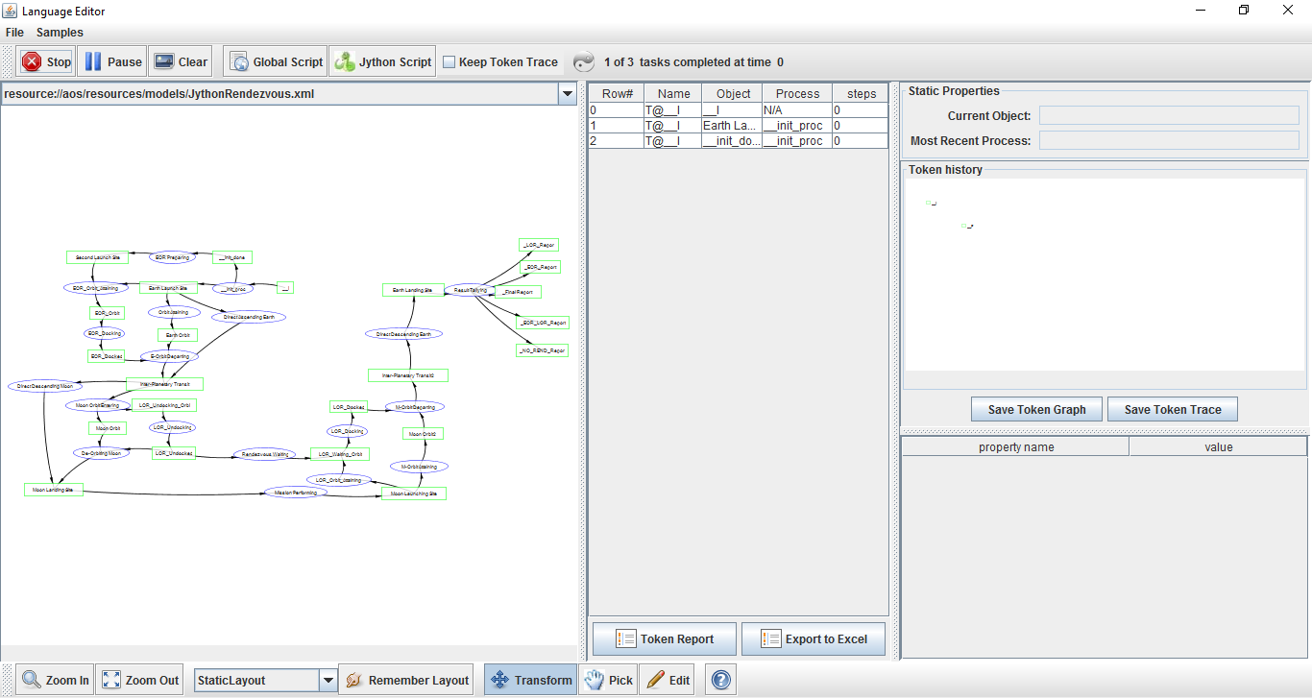
Complex Diagram Can be Simplified by Category Theory
CATEGORY THEORY
OPN Program
computes all the possible
trayectories to
the moon and
back
Author:
Benjamin Koo

Slide 72
How Category Theory Simplifies Product Development
For a start-up, there are two possible outcomes which define two maneuvers, one reversible:
Succeed after a process, advance
Failed after a process, repeat, roll back [opposite from advance]
Repeat
Identify customer needs and problems
Advance
Advance (R&D)
Repeat
Roll Back
Roll Back
Repeat
Target specification and proof of concept
Roll Back
Development techniques / framework
Advance

Slide 73
How Category Theory Simplifies System Development
Can be simplified as :
A
B
Domain
Codomain
Data Gathering
Data Specifications
Identity Functor
Identity Functor
Eevery connection is reversible
Codomain
Domain
Infinite possibilities!!!
Find the viable paths to succeed!
Notes:
Identity functor

Slide 74

Guide book
https://dewabharata.gitbooks.io/category-theory-for-dummies-by-dummies/content/

Slide 75
2017年工程管理硕士（MEM）第二批次入学导引课程
学员手册答辩
张恪易
2017年9月17日

Slide 76
3. 撰写学员手册的依据
1.
2.
3.
4.
意识形态
生产资料
生产力
方法论
我们自身对课程的基本诉求
戴老师连夜赶制的初版学员手册
第三组同学输出的XLP课程逻辑模型
函子和自然转换等范畴论计算思维和概念

Slide 77
4. 学员手册中所涉及到的范畴论知识
A category is a graph with a rule for composing arrows head to tail to give another arrow。
A
F
B

Slide 78
4. 学员手册中所涉及到的范畴论知识
逻辑模型
学员手册
F
A戴
B戴
f
αG
自然转换
h
CMEM
DMEM
G

Slide 79
5.举例说明逻辑模型的过程部分
不变量：四天的课时、所学的课程
可变量：课程单元、课程顺序
过程
过程
4天MEM导引课，三个课程单元。
单元一：认识自己
单元二：认识清华
单元三：清华与我
课程单元一「认识自己」：
优势测试
个人简历制作（自发迭代）
课程单元二「认识清华」：
校园探索
定向越野
实验室探究
社团资源
课程单元三「清华与我」：
上期班级宪章
辩论班级宪章制定的方法论
上期汇报演出
制定班级宪章
课程单元一「同学与我」：
破冰游戏
课程引导
班长选举
工具讲解
课程单元二「清华与我」：
认识清华
定向越野
图书馆介绍
实验室探究
课程单元三「MEM与我」 ：
分享经验
软件培训
班级宪章
课程单元四「终极汇报」

Slide 80
学生手册编制工作流程
第一阶段
第二阶段
第三阶段
第四阶段
小组内部协作，
在第三天的晨间汇报时，分别汇报学员手册初稿。
根据反馈，班委与学生代表协商确定学员手册逻辑架构。
按章节将任务分解，派至小组长，分工协作（可打破原有分组），并于第三天18:00前提交初版成果。
班委整合出学员手册初稿，并对内容进行审核。
将意见反馈，由各组长进行版本迭代。
如此反复，于第三天24:00提交最终版本。
班委将各小组提交的终板成果进行整合，并于第四天9:00前形成终稿。将其交至美工组，进行版面设计，交付打印。

Slide 81
学生手册编制工作流程
存在的问题：
1.逻辑框架过粗，各分组理解与班委不一致，拼装稿离预想偏离较大。造成班委审稿、修订难度大。
2.在短时间内，班委任务集中，精力分散，集中审稿时人员过少，压力太大。
经验总结：
1.分工时应相对明确工作包，避免发挥维度过大，偏离原意。
2.没有建立工作规则，班委如果不能按照约定履行审稿义务，应当报告班长、建议合适人员参加审稿。

Slide 82
参考文献
[1].戴慧玲,清华大学工程管理硕士MEM入学导引课程《2017年-第二批次》学员手册 2017-V3.0版,2017.第16页.
[2].Ben Koo, Computational Thinking in Category Theory.
[3].M. Barr, and C. Wells, Category theory for computing science. 1990. 21.

Slide 83

叶盛誉

Slide 85
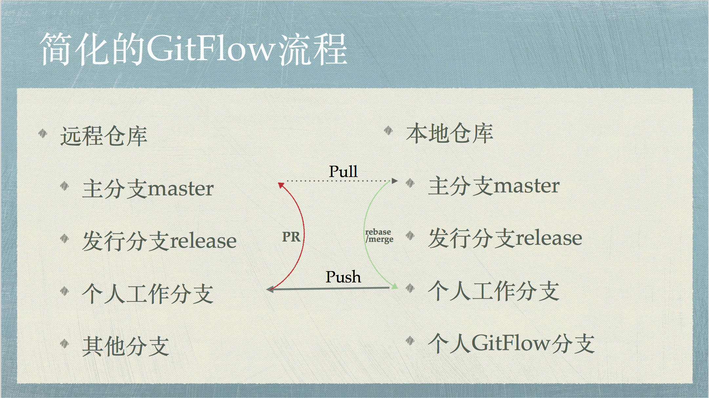
这张图像什么？

Slide 86
02
工具使用
02
多种函数（隐喻）系统的调用

Slide 87


Demo Time
01
02
NetLogo
Mathematica
極限學習過程
極限學習過程
87

Slide 88
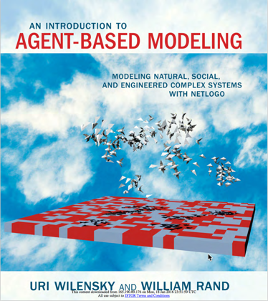
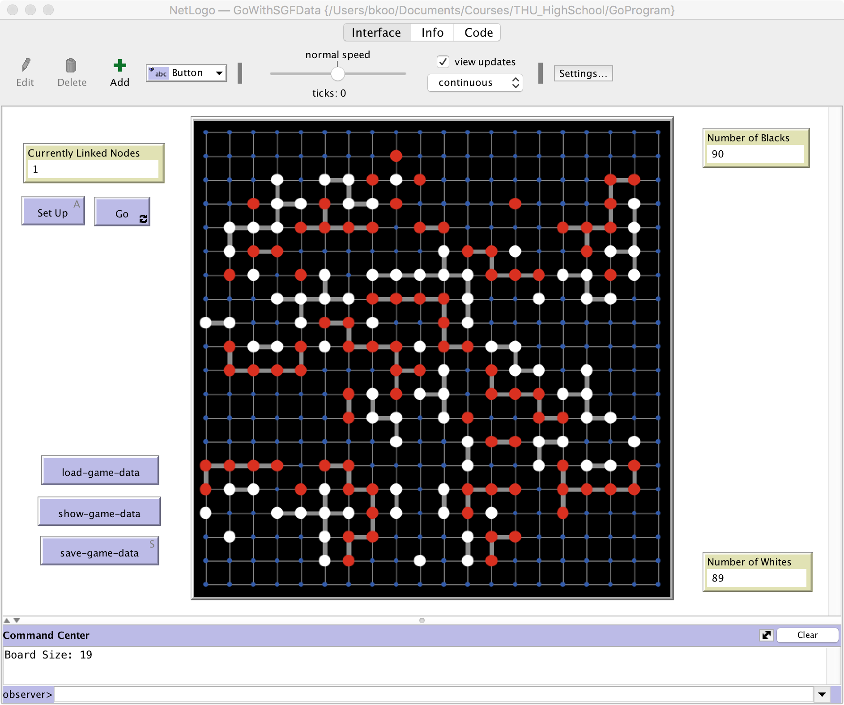
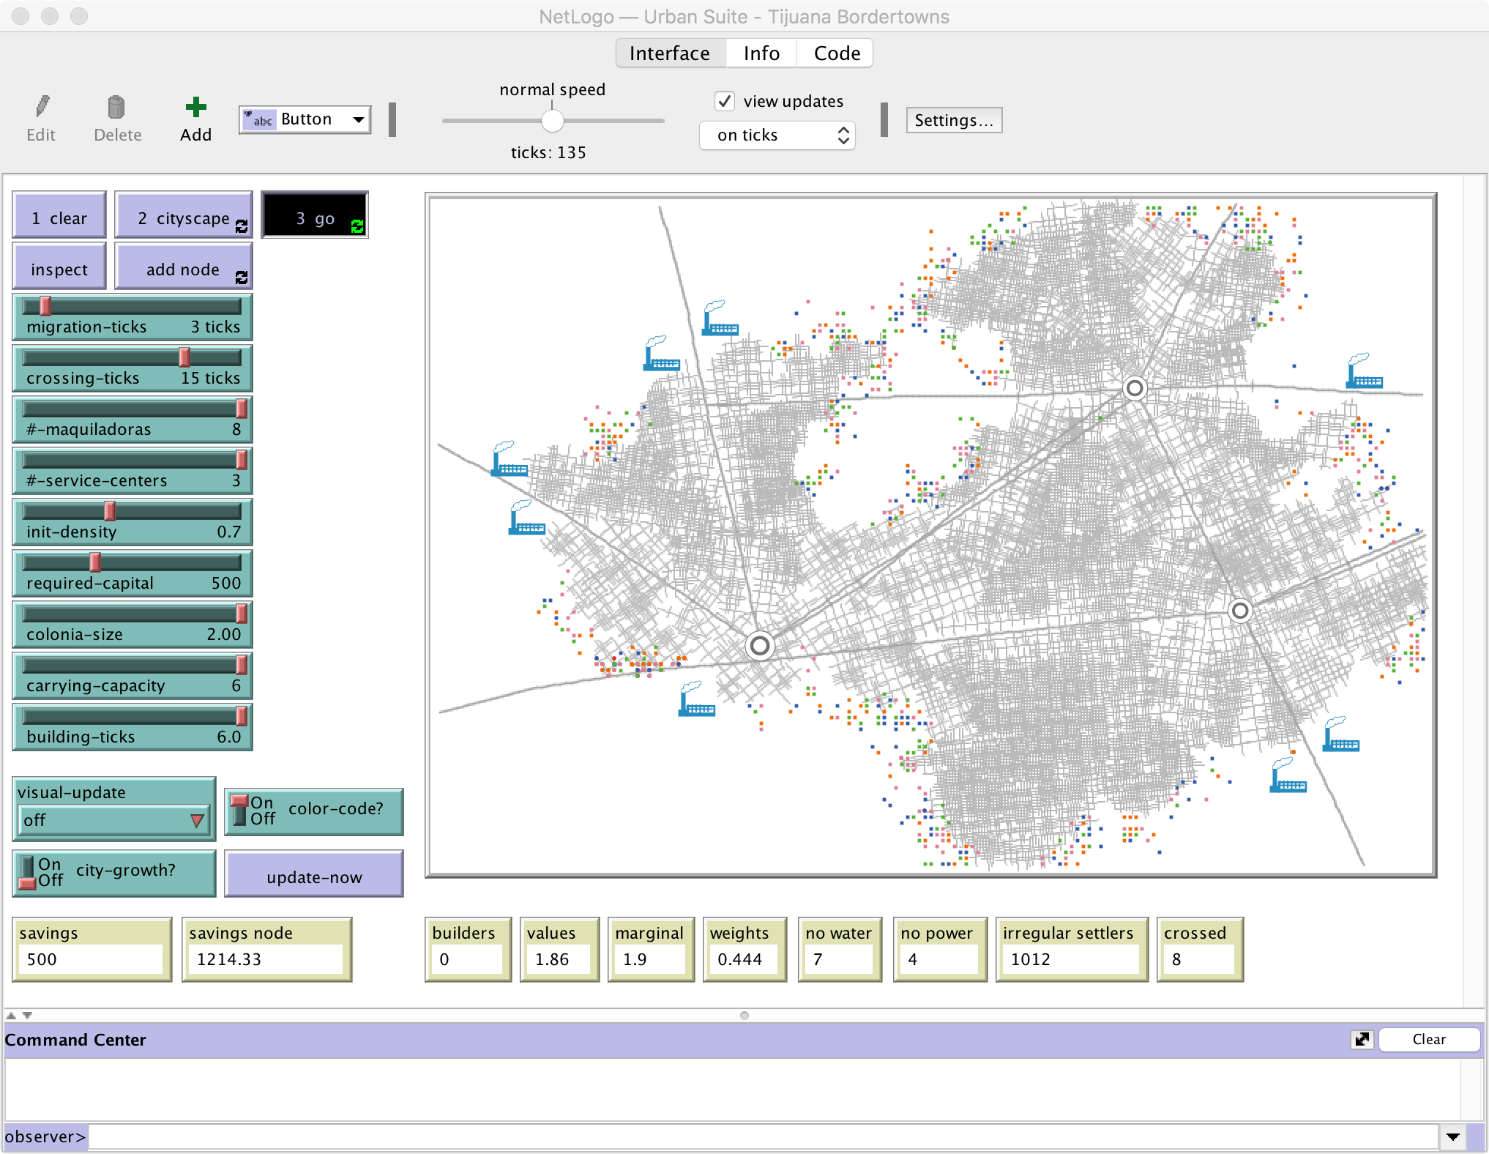
复杂网络专用的编程语言 NetLogo
Agent-based Modeling

Slide 89
范畴论：复杂网络的数学 （John Baez）
尤亦庄： …引力、量子纠缠和人工智能正是在这里走到了一起。它们之间涌现出一个共同的主题，那就是复杂网络。-
本页的图文来自尤亦庄的 “引力、量子与人工智能的深度对话”
：http://mp.weixin.qq.com/s/UBG8-3FKkyE6DrUJ2CXIAA

Slide 90
总结：
认知的本源来自事物之间的可比性
Lakoff: 事物之间的关系共有三种：本体、结构、时空相对性
范畴论提出一套态射体系：描述 比喻／隐喻的数理逻辑方法
Eilenburg & Mac Lane: 三种态射：函数、函子、自然转换
当代的计算科学奠基于范畴论，
梳理数学领域的工具 （哲学与量子重力场）
编译器的优化
软件工程与系统工程
Lawvere Foundation 提出了范畴论通用于其他领域的假设 (Conceptual Mathematics)

Slide 91
参考文献：
An introduction to Category Theory for Software Engineers， Steve Easterbrook, U of Toronto: http://www.cs.toronto.edu/~sme/presentations/cat101.pdf
Conceptual Mathematics, F. William Lawvere, SUNY Buffalo, http://www.cambridge.org/catalogue/catalogue.asp?isbn=9780521719162

